Slide 1
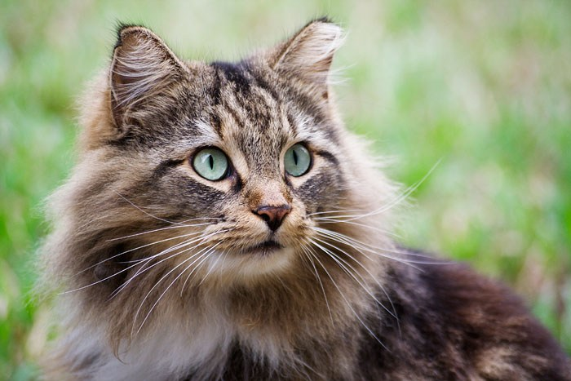
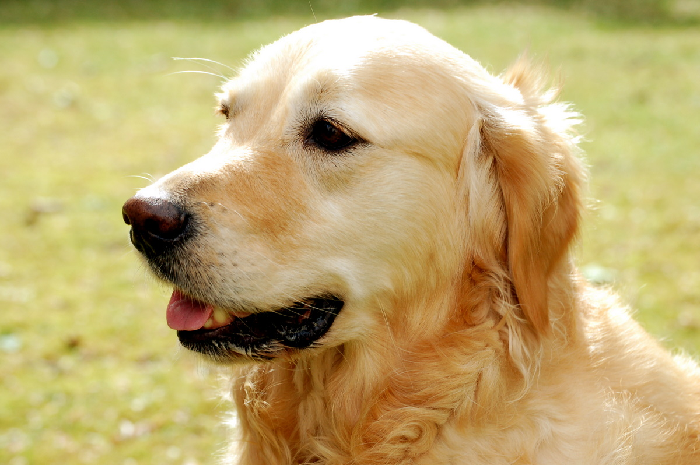
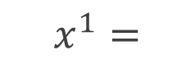
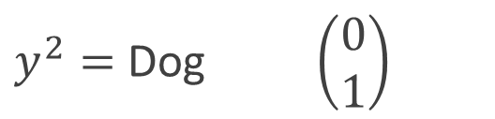
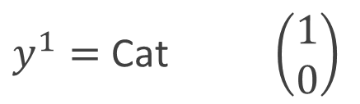
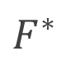
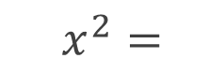
$$x^{1}=$$
$y^{1}=$ Cat $\left(\begin{matrix}1 \\ 0\end{matrix}\right)$
$F^{∗}$
$$x^{2}=$$
$y^{2}=$ Dog $\left(\begin{matrix}0 \\ 1\end{matrix}\right)$

Slide 2

(Target)
$$𝓗$$
(Hypothesis space)

Slide 3
(Target)
Approximation
Error
$$𝓗$$
(Hypothesis space)
(Best Model)

Slide 4
(Target)
Approximation
Error
$$𝓗$$
(Hypothesis space)
(Best Model)
(Initial Guess)
Optimization/Training
(Learned Model)

Slide 5
(Target)
Approximation
Error
$$𝓗$$
(Hypothesis space)
(Best Model)
(Initial Guess)
Optimization Error
Optimization/Training
(Learned Model)
Empirical Risk Minimizer

Slide 6
(Target)
Approximation
Error
$$𝓗$$
(Hypothesis space)
(Best Model)
Generalization
Error
(Initial Guess)
Optimization Error
Optimization/Training
(Learned Model)
Empirical Risk Minimizer

Slide 7
Fully Observed
System with Memory
RNN
Partially Observed Markovian System
Mori-Zwanzig
Formalism

Slide 8

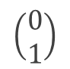
$$F^{∗}$$
Dog
$$\left(\begin{matrix}0 \\ 1\end{matrix}\right)$$

Slide 9

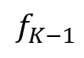
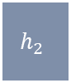

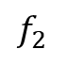
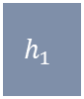
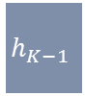
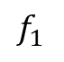

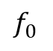
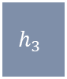

$$x$$
$$h_{1}$$
$$h_{2}$$
$$h_{3}$$
$$…$$
$$h_{K−1}$$
$$h_{K}$$
$$\hat{y}$$
$$f_{0}$$
$$f_{1}$$
$$f_{2}$$
$$f_{K−1}$$

Slide 10
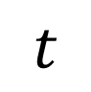
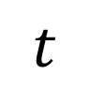


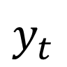
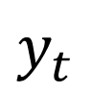
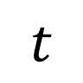
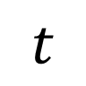
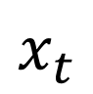
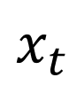
$$\left\{H_{t}^{∗}\right\}$$
$$x_{t}$$
$$y_{t}$$
$$t$$
$$t$$
$$\left\{H_{t}^{∗}\right\}$$
$$x_{t}$$
$$y_{t}$$
$$t$$
$$t$$

Slide 11
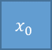

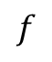
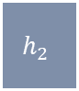

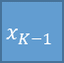
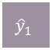
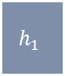
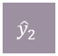
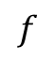

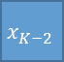

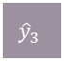
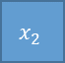
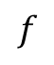


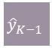
$${\hat{y}}_{1}$$
$${\hat{y}}_{2}$$
$${\hat{y}}_{3}$$
$${\hat{y}}_{K−1}$$
$${\hat{y}}_{K}$$
$$h_{1}$$
$$f$$
$$h_{2}$$
$$f$$
$$h_{3}$$
$$…$$
$$h_{K−1}$$
$$f$$
$$h_{K}$$
$$x_{0}$$
$$x_{1}$$
$$x_{2}$$
$$x_{K−2}$$
$$x_{K−1}$$

Slide 12
Dynamic
Input-Output Problem
RNNs
Approximation
Generalization
Optimization
UAP in linear case
Rates in linear case
Nonlinear functionals?
Dynamical analysis of “plateauing” behavior
Nonlinear case?
Gated networks and their interactions?

Slide 13
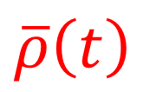
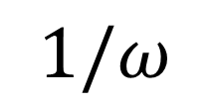
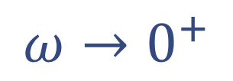
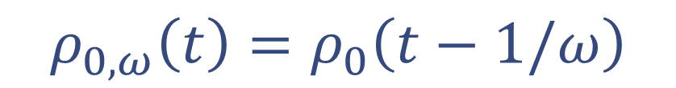
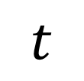
$$ρ_{0,ω}\left(t\right)=ρ_{0}\left(t−1/ω\right)$$
$$\overline{ρ}\left(t\right)$$
$$ω→0^{+}$$
$$1/ω$$
$$t$$

Slide 14
Dynamical Systems Approach
Optimization
Generalization
Basic non-vacuous estimates
Function spaces and complexity measures?
Approximation
Mean-Field Optimal Control
Local Condition
Global Condition
Sufficient conditions for approximation using depth
Approximation rates for good choices of function spaces?
Method of Characteristics
Mean-field PMP
Mean-field HJB
Novel Algorithms
Generalized back-prop
Training Algorithms?

Slide 15
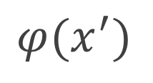
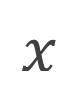
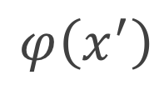
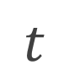
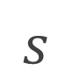
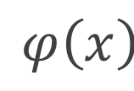
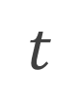
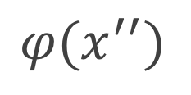












$$t$$
$$t$$
$$φ\left(x\right)$$
$$φ(x^{′})$$
$$φ\left(x^{′′}\right)$$
$$φ\left(x\right)$$
$$φ(x^{′′})$$
$$φ\left(x^{′}\right)$$
$$T$$
$$T$$
$$s$$
$$\hat{x}$$
$$x$$
$$x′$$
$$x′′$$
$$State$$
$$x$$
$$x′$$
$$x′′$$
$$State$$

Slide 16







$$t$$
$$T$$
$$s$$
$$x$$
$$x′$$
$$x′′$$
$$x_{0}$$

Slide 17


$$Ω$$
$$Ω$$
$$Ω$$

Slide 18








$$𝓖∘\left(OP Homeo\right)$$
$$𝓖∘\left(OP Homeo\right)$$
$$F^{∗}$$
$$F^{∗}$$
$$𝓗$$
$$𝓗$$
$$\overline{𝓗}$$
$$\overline{𝓗}$$

Slide 19
$$𝓖∘\left(OP Homeo\right)$$
$$F^{∗}$$
$$𝓗$$

Slide 20



Dynamics: ${\dot{x}}_{t}=h\left(x_{t}\right)$
$$h\left(x\right)$$
$$Ω$$
Does not move

Slide 21



Approximation of Functions by Composition $$𝓖∘Φ$$
Linear Approximation
The Problem of Approximation
$Φ$ fixed $𝒢$ linear
Continuum Idealization
Deep NNs
(ResNet)
Continuous Dynamical System
Nonlinear Approximation
$Φ$ ODE $𝒢$ simple
Direct Approaches
Important Questions
Approximation rates
Function spaces
Symmetry
UAP For ResNets and Variants
Convergent Discretization
UAP For Flow Maps

Slide 22


ResNet
$$x_{k+1}=x_{k}+f\left(x_{k},θ_{k}\right)$$
Dynamical System
$${\dot{x}}_{t}=f\left(x_{t},θ_{t}\right)$$
Continuum Idealization

Slide 23









Target $F^{∗}$
$$x$$
$$y$$
$$≈$$
$${\dot{x}}_{t}=f\left(x_{t},θ_{t}\right)$$
$$\hat{y}=g\left(x_{T}\right)$$
$$x_{0}$$
$$x_{T}$$
$$\hat{y}$$
Transformation Family
Terminal Family

Slide 24


Dynamical Systems
Approach
Approximation
Generalization
Optimization
Infinite Dimensional Controllability
Numerical Analysis $Γ$-convergence
Sufficient condition for universal approximation
Approximation rates?
Function spaces?
Mean-field Optimal Control
$Γ$-convergence of sample to population
$Γ$-convergence of layer-discretization
Convergence rates?
Local Condition
Global Condition
Mean-field Pontryagin’s Maximum Principle
Mean-field Hamilton Jacobi Bellman Equation
PMP-based algorithms
Parallel algorithms
Landscape and dynamics?
Learning algorithms?

Slide 25







Self-Driving
Machine Translation
Game-Playing
Practical Success vs. Theoretical Mystery
Science and Engineering
Molecular Dynamics
Phase Transitions
Conformational Changes
Emerging Applications
# of condensed mattter papers on arXiv containing “learning” in the title

Slide 26




Deep NN
Data in Scientific Applications
Stochastic Gradient Algorithm
Conformational changes in macromolecules
Damage evolution
In self-healing materials
Input
Output
Recurrent NN
Loss
Input
Output
Epoch

Slide 27
Deep Neural Network
Input
Output
Dynamical Evolution of Features

Slide 28






Deep (Residual) Neural Network
Continuous-time Dynamical System
$$x_{k+1}=x_{k}+f_{k}\left(x_{k},θ_{k}\right)$$
$${\dot{x}}_{t}=f_{t}\left(x_{t},θ_{t}\right)$$
Input
Output
Input
Output
Composition
Dynamics
Continuum Idealization
Linear Elasticity Equations
Solids
$$∇⋅σ+F=ρ\ddot{u}$$
Navier Stokes Equations
Fluids
$$\dot{u}+\left(u⋅∇\right)u=−ρ^{−1}∇P+ν∇^{2}u$$

Slide 29












Target $F^{∗}$
$$x$$
$$y$$
$$≈$$
$${\dot{x}}_{t}=f_{t}\left(x_{t}\right)$$
$$\hat{y}=g\left(x_{T}\right)$$
$$x_{0}$$
$$x_{T}$$
$$\hat{y}$$
Transformation Family $$Φ\left(ℱ,T\right)=\left\{x_{0}↦x_{T}:{\dot{x}}_{t}=f_{t}\left(x_{t}\right),f_{t}∈ℱ\right\}$$
Terminal Family $$\left\{g:g∈𝒢\right\}$$
Dynamical Hypothesis Space $$ℋ\left(ℱ,𝒢\right)=∪_{\left\{T≥0\right\}}\left\{g∘φ:g∈𝒢,φ∈Φ\left(ℱ,T\right)\right\}$$

Slide 30


Target $F^{∗}$
$$x$$
$$y$$
$$≈$$
$${\dot{x}}_{t}=f_{t}\left(x_{t}\right)$$
$$\hat{y}=g\left(x_{T}\right)$$
$$x_{0}$$
$$x_{T}$$
$$\hat{y}$$
Transformation Family $$Φ\left(ℱ,T\right)=\left\{x_{0}↦x_{T}:{\dot{x}}_{t}=f_{t}\left(x_{t}\right),f_{t}∈ℱ\right\}$$
Terminal Family $$\left\{g:g∈𝒢\right\}$$

Slide 31








Find curve connecting A$→$B so that ball rolls down in shortest time
- Johann Bernoulli (1696)
Answer: Cycloids
This led to the development of calculus of variations and optimal control
Euler
Lagrange
Weierstrass
Pontryagin
Bellman

Slide 32
Open Loop
Closed Loop
State
State
State
State
State
State
Control
Control
Controller

Slide 34
$$Ω$$

Slide 35
Machine Learning
Stochastic Differential Equations
Partial Differential Equations

Slide 36



Continuous
Discrete
Stochastic

Slide 37



Cat
Dog
$$x$$
$F^{∗}$
$$y=F^{∗}\left(x\right)$$

Slide 39
Shallow NN
Deep NN
Increasing complexity
Input
Output
Input
Output
Increasing complexity

Slide 40



Pontryagin
Bellman

Slide 41



$$J$$
$$θ$$

Slide 42



Slide 43



RNN
WaveNet (CNN)
Transformers

Slide 44





Reduction
Reconstruction
Rayleigh Bénard Convection
Lorenz ‘63 Model
Reduction
Motion of DNA Strand
Extension Dynamics

Slide 45



Onsager Principle
$$M\dot{h}=−∇V(h)$$
Generalize
Approximate via Deep NNs
$$\left(M\left(h\right)+W\left(h\right)\right)\dot{h}=−∇V\left(h\right)+f\left(h\right)$$
Advantages
Captures general dissipative dynamics accurately
Stable, physically relevant learned quantities

Slide 46








Stochastic Gradient Flows
$$\dot{h}=−∇V\left(h\right)+\sqrt{2ε} ξ$$
$$h∈ℝ^{m}$$
Generalize
Autograd
$$∇V\left(h\right)$$
$$V\left(h\right)$$
$$g\left(h\right)$$
Approximate via Deep NNs
$$\dot{h}=−∇V\left(h\right)+g\left(h\right)+\sqrt{2ε} ξ$$
$$g⊥∇V$$
$V$ is quasipotential
Output: $−∇V\left(h\right)+g\left(h\right)$
Advantages
Captures general stable, non-gradient dynamics at low temperatures
Quasipotential landscape can be used to analyze stability/exit probabilities
Loss function penalizes
$$\left\|∇V^{T}g\right\|$$

Slide 47



Fast Decay, High Rank
Slow Decay, Low Rank
$$ρ^{\left(H^{∗}\right)}$$
$$ρ^{\left(H^{∗}\right)}$$
$$t$$
$$t$$

Slide 48

Recurrent Encoder-Decoder
Transformer

Slide 49


Historical Data
Prediction
Future
Time-Series/Dynamics Prediction
Present
Language 1
Language 2
Google Translate is a multilingual neural machine translation service
谷歌翻译是一种多语言神经机器翻译服务
Machine
Translation
Control
Response
$$u\left(t\right)$$
$$\dot{x}\left(t\right)=f(x\left(t\right),u\left(t\right))$$
Control Systems

